Slide 1
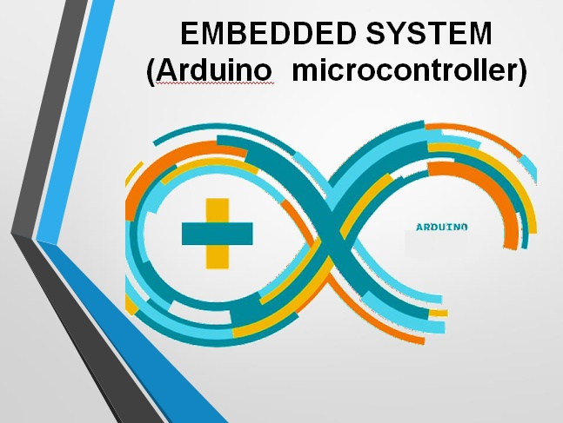


EMBEDDED SYSTEM (Arduino microcontroller)

Slide 2
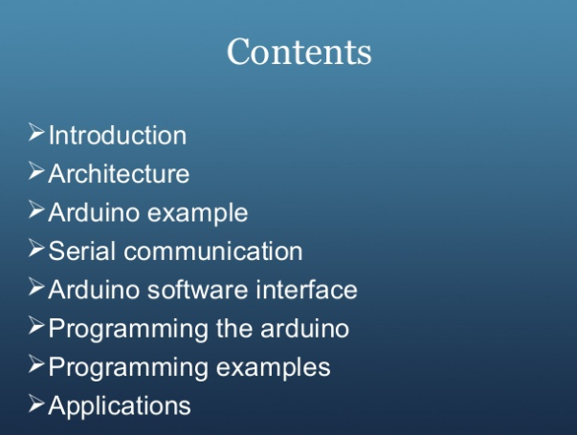

Slide 3
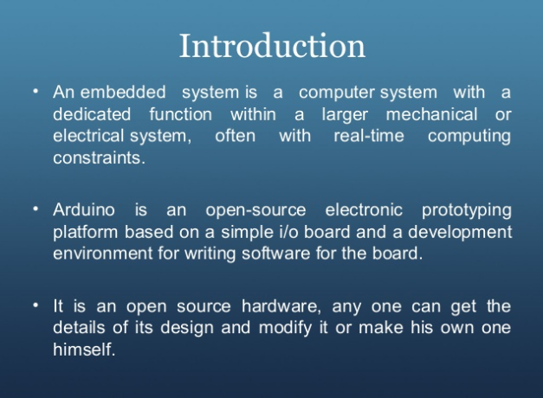

Slide 4
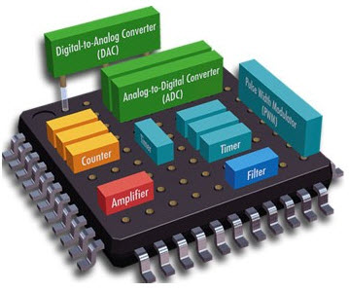
Embedded system
An embedded system is a combination of computer hardware and software, either fixed in capability or programmable

Slide 5
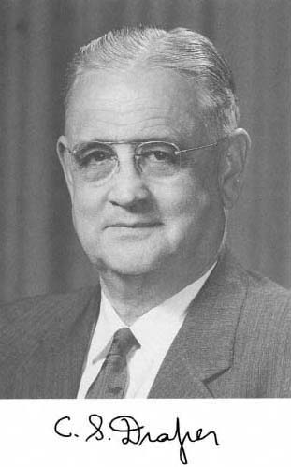
Charles Stark Draper

Slide 6


Slide 7
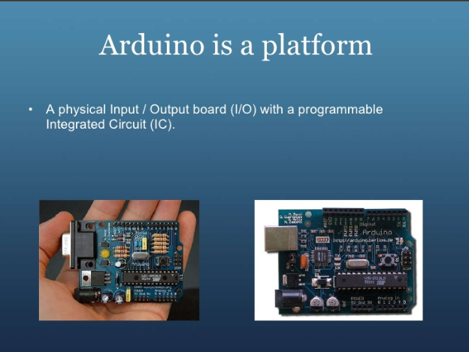

Slide 8


Slide 9
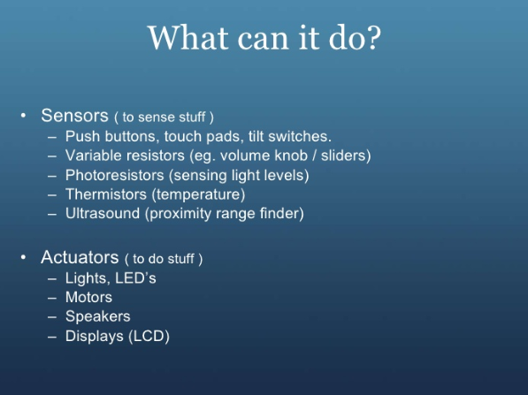

Slide 10


Slide 11
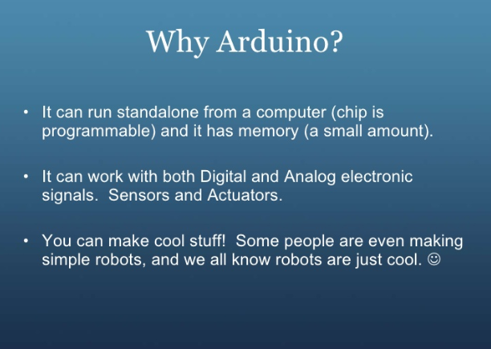

Slide 12


Slide 13
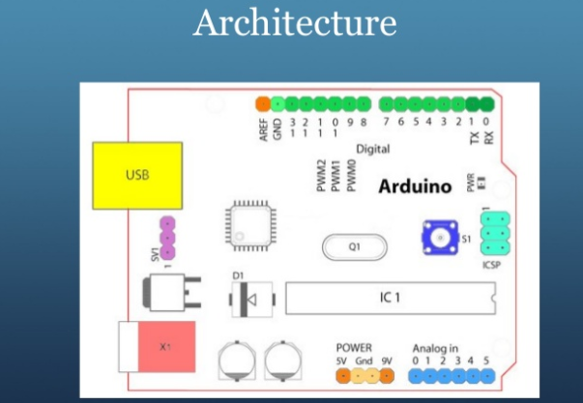

Slide 14
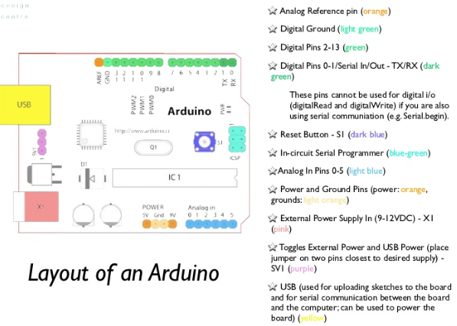

Slide 15
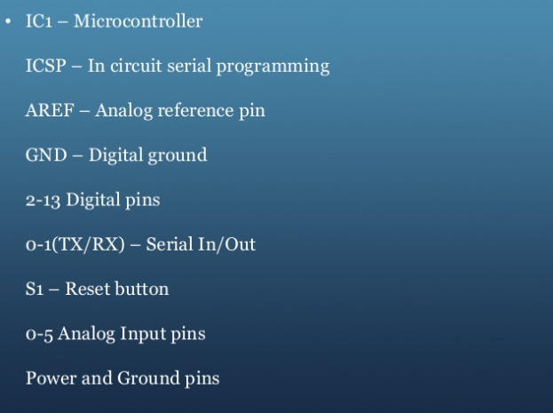

Slide 16
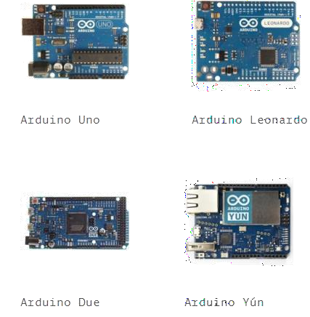
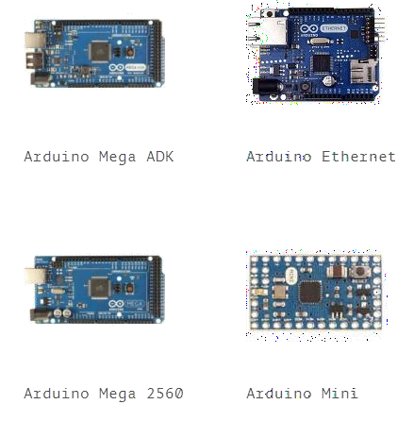
Arduino Family

Slide 17
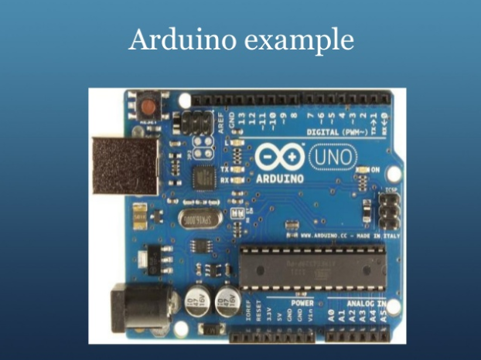

Slide 18
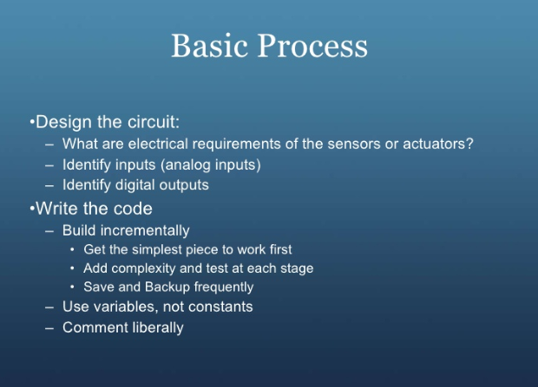

Slide 19
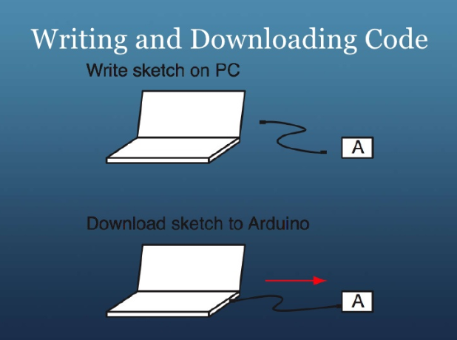

Slide 20
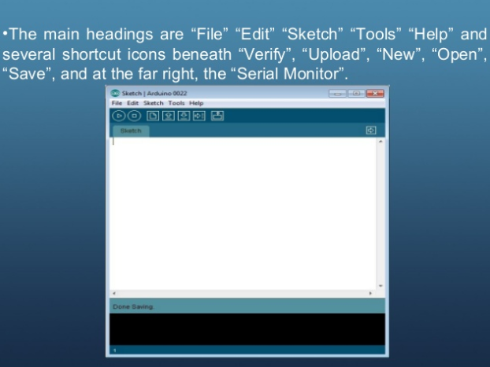

Slide 21
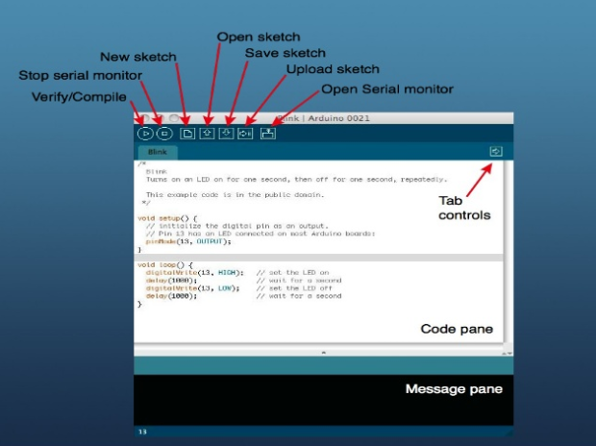

Slide 22
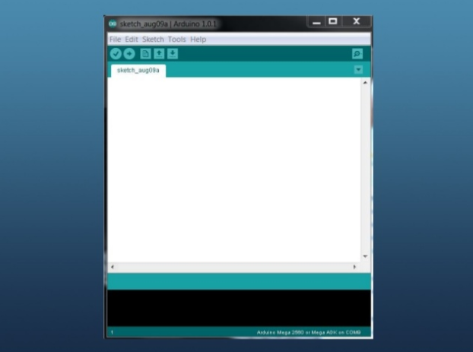

Slide 23
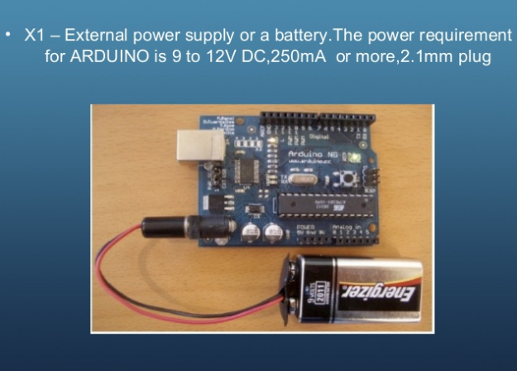

Slide 24
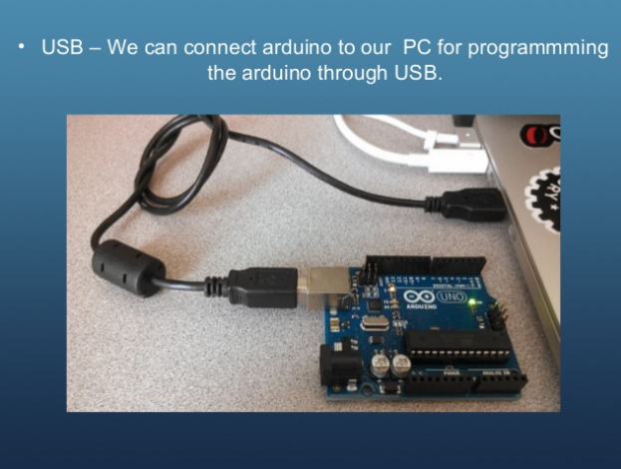

Slide 25
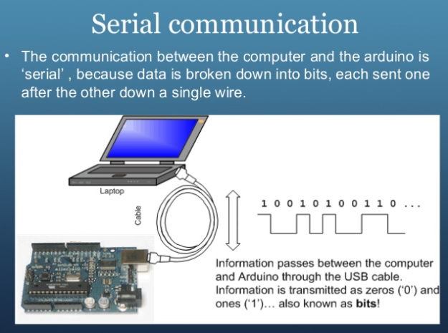

Slide 26
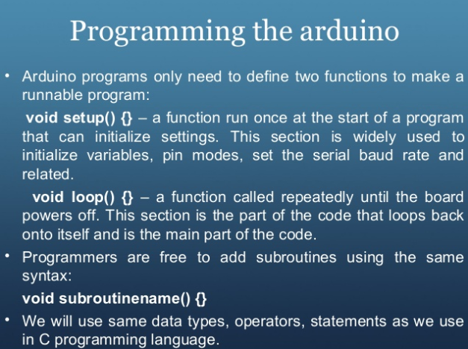

Slide 27
Programming
void setup()
{
// put your setup code here, to run once:
}
void loop()
{
// put your main code here, to run repeatedly:
}

Slide 28
Bare minimum code
setup : It is called only when the Arduino is powered on or
reset. It is used to initialize variables and pin modes
loop : The loop functions runs continuously till the device is
powered off. The main logic of the code goes here.
Similar to while (1) for micro-controller programming.

Slide 29
PinMode
A pin on arduino can be set as input or output by using
pinMode function.
pinMode(13, OUTPUT); // sets pin 13 as output pin
pinMode(13, INPUT); // sets pin 13 as input pin

Slide 30
Reading/writing digital values
digitalWrite(13, LOW); // Makes the output voltage on pin
13 , 0V
digitalWrite(13, HIGH); // Makes the output voltage on pin
13 , 5V
int buttonState = digitalRead(2); // reads the value of pin 2 in buttonState

Slide 31
What are Libraries?
Libraries are a collection of code that makes it easy for you to connect to a sensor, display, module, etc. For example, the built-in LiquidCrystal library makes it easy to talk to character LCD displays. There are hundreds of additional libraries available on the Internet for download.

Slide 32
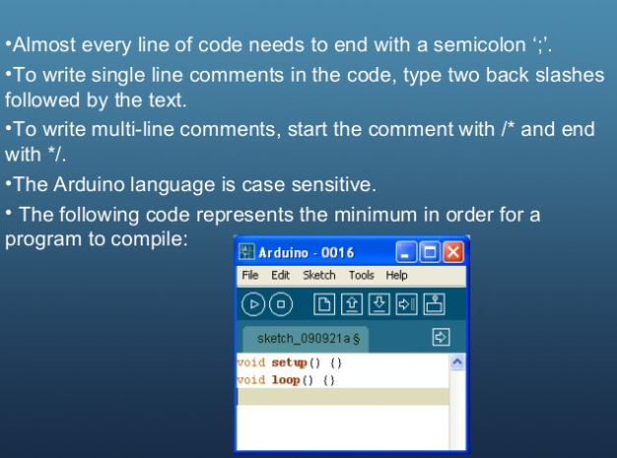

Slide 33
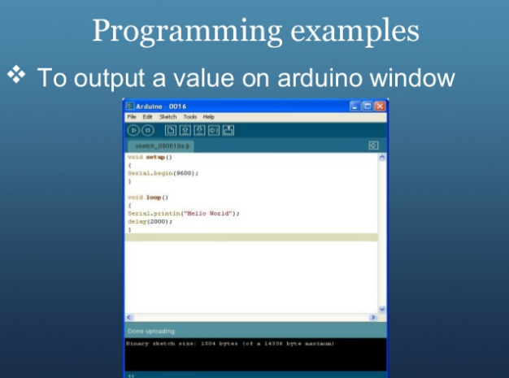

Slide 34
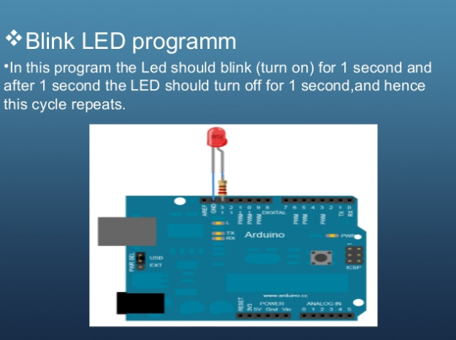

Slide 35
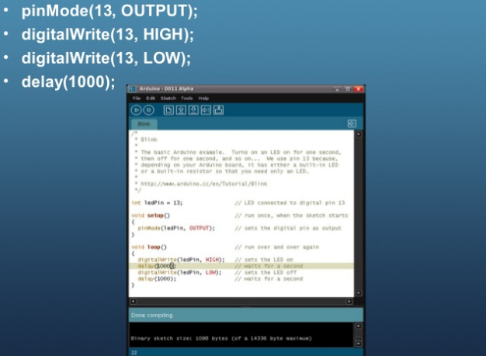

Slide 36
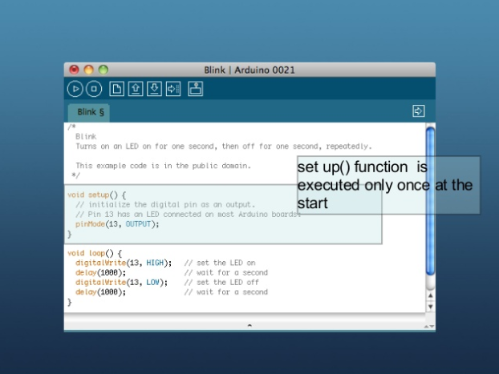

Slide 37
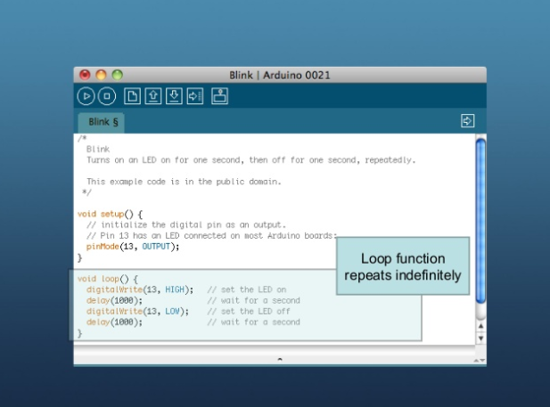

Slide 38
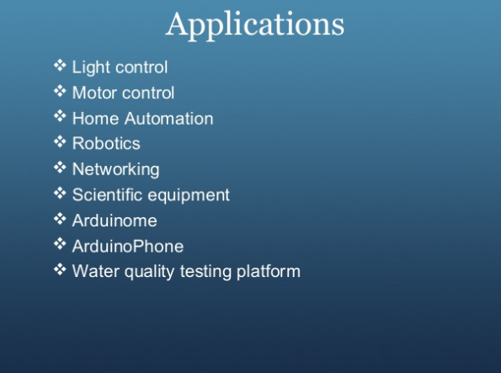

Slide 39
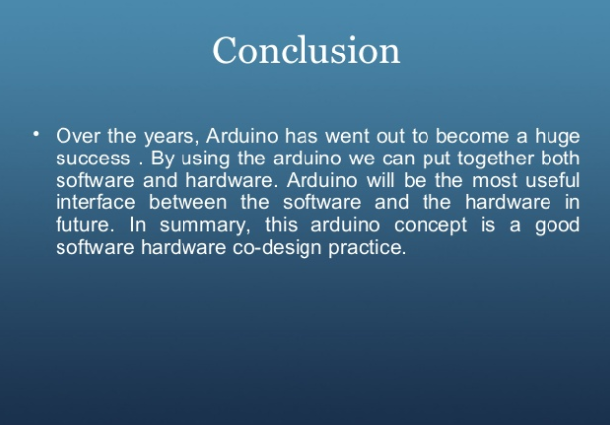

Slide 40


Slide 41
